Slide 1
Update to S-100 FCB v2.0
Nautical Information Provision Working Group (NIPWG)
Republic of Korea (KHOA)

Slide 2
Contents
Introduction
Identification of revisions to the S-100 FCB
Results of the Update to the S-100 FCB
Discussion
Future plan

Slide 3
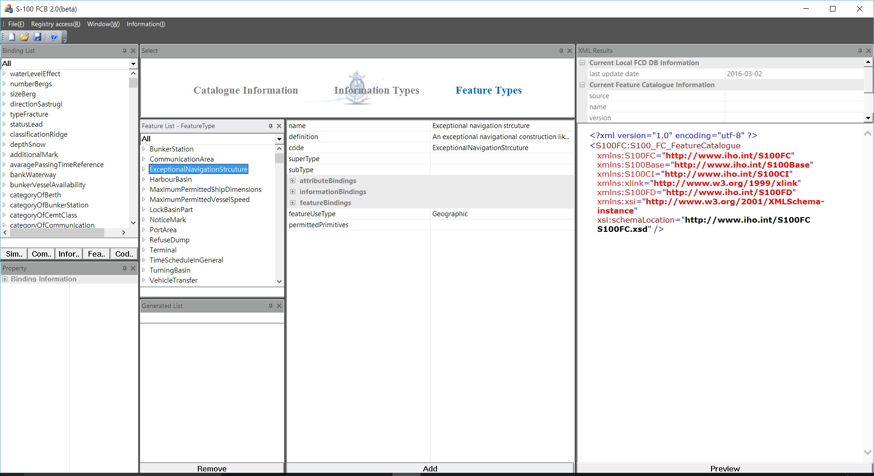
Introduction
The KHOA has developed the S-100 Feature Catalogue Builder (FCB)
S-100 FCB v1.0: 2014 , S-100 FCB v1.1: 2015
Created S-101 Feature Catalogue (FC)
Need to update S-100 FCB
New version of S-100 (v2.0.0)
User requirement / feedback from IEHG
Report updated on S-100 FCB v2.0
S-100 FCB v2.0

Slide 4
Identification of revisions to the S-100 FCB
Test operation of the S-100 FCB by Inland domain
Network: S-100 FCB could not access the S-100 FCD Register
due to the security policy of the user’s organization. (mobile network was used)
Access: S-100 FCB very slow due to the time taken for logging in and loading the FCD Register DB from the Registry, and loading saved FC from the S-10X FC DB.
FC Schema: The existing feature catalogue for Inland ENCs from the Inland domain was not loaded.
Functions: Several errors were found in some parts of the S-100 FCB.
Notes:
The KHOA asked the Inland domain to test the S-100 FCB and received comments on the evaluation and revisions. The comments can be summarized as below:
Network: S-100 FCB could not access the S-100 FCB Registry due to the security policy of the user’s organization. (Since the S-100 FCB was not working due to a network problem, a mobile network was used instead of the organization’s network.)
Access: The mobile network made the S-100 FCB very slow due to the time taken for logging in with a user ID and PW, loading the FCD Register DB from the Registry, and loading saved FC from the S-10X FC DB.
FC Schema: The existing feature catalogue for Inland ENCs from the Inland domain was not loaded.
Functions: Several errors were found in some parts of the S-100 FCB.

Slide 5
Identification of revisions to the S-100 FCB
Recognized as…
S-100 FCB can be largely affected by communication network
Loading FCB Register DB or loading/saving FC in FC DB is not a work done frequently when using the S-100 FCB
Introduce local FCD DB
Export / import FC XML files without connection to the FCD register
Manage FC DB in the registry by the register manager

Slide 6
Results of the Update to the S-100 FCB
New S-100 FCB v2.0 to minimize dependence on the network;
Design and develop the local FCD DB within S-100 FCB in an XML format
Update procedure of the local FCD DB
Improvement of the process of FC compilation and uploading the S-10X FC to the FC DB of S-100 Registry
Adjust the version number of FCB to the S-100 (S-100 v2.0 = FCB v.2.0.x), 0.0.X can be used to indicate an error revision and function improvement

Slide 7
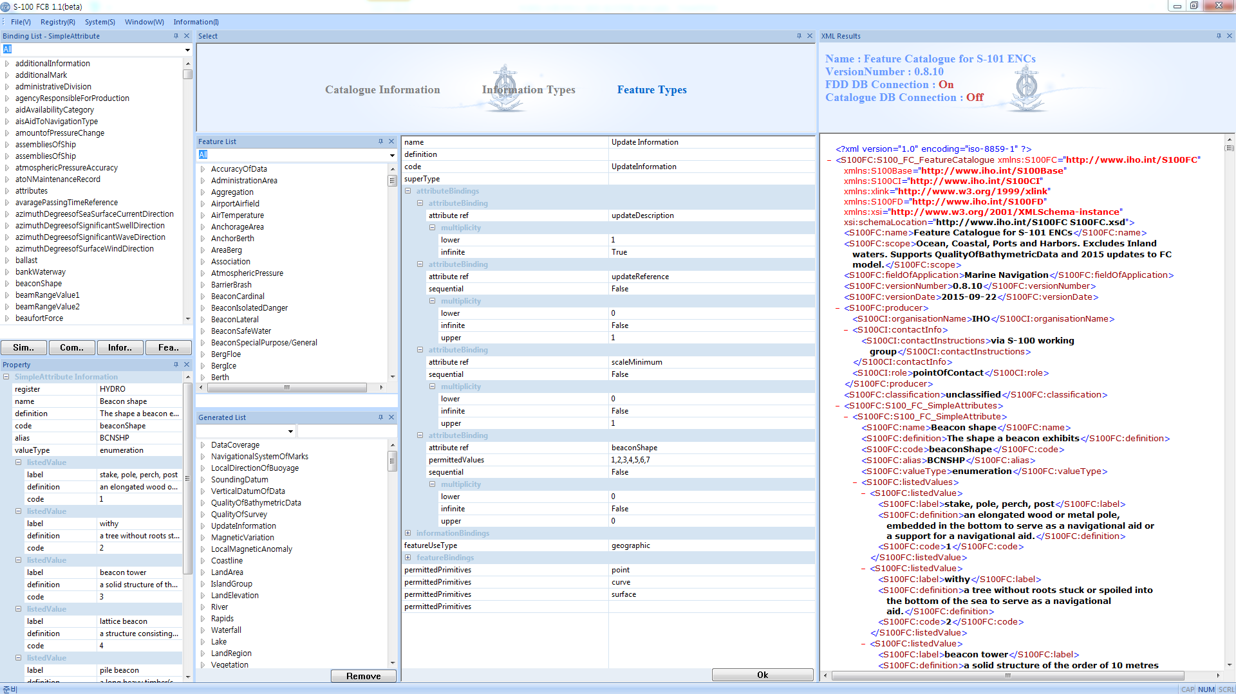
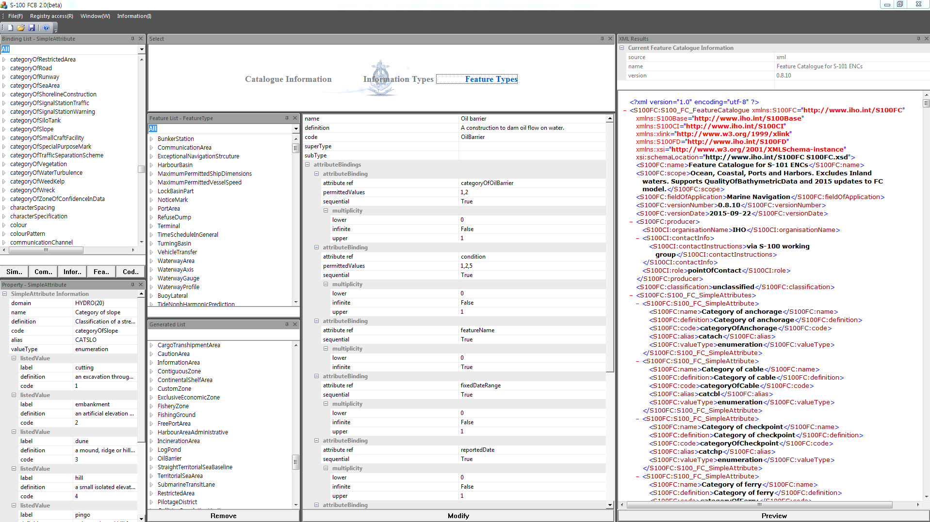
Results of the Update to the S-100 FCB(Cont.)
Comparison between S-100 FCB 1.1 and S-100 FCB 2.0
S-100 FCB 1.1
S-100 FCB 2.0
Save
Feature Catalogue DB
Load
Load
S-100 Registry
FCD Register
Load
Portrayal Register
Export
Load
Update
Load
Export
Load
S-10X
Feature
Catalogue
Local DB
On FCD Register
S-10X
Feature
Catalogue

Slide 8
Results of the Update to the S-100 FCB(Cont.)
Applied to Feature Catalogue Schema updated by Jeppesen according the feature catalogue model of S-100 ver. 2.0.
S-100 FCB was improvement in terms of function and user interface.

Slide 9
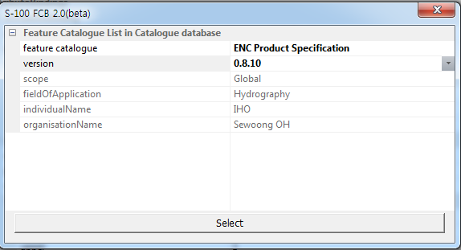
Results of the Update to the S-100 FCB(Cont.)
S-10X PS developers
Registry Manager or Register Manager
S-100 FCB 2.0
Feature Catalogue DB
Load
S-100 Registry
FCD Register
Portrayal Register
Update
Load
Export
Load
Local DB
On FCD Register
S-10X
Feature
Catalogue

Slide 10
Discussion topics
S-100WG1 is invited to discuss several topics raised in updating the S-100 FCB.
Operating FCD Register local DB within S-100 FCB
Manage and save to FC DB by register manager
User accounts of S-100 FCB to update local FCD DB
Use of registered items depending on status
Only valid items in FCD Register BUT need to use invalid (proposed) items in the FCD Register ?
Proposed to use both (valid and invalid) items

Slide 11
Future plan
ROK planed like below considering the test operation of S-100 Registry:
Test between S-100 Registry DB and S-100 FCD in conjunction with the operation of S-100 Registry
Update S-101 FC using S-100 FCB v2.0
Provide S-100 FCB v2.0 and support technical issues
Tutorial and manual on S-100 FCB

Slide 12
Action Required of NIPWG2
The NIPWG2 is invited to:
note the progress reported in this paper.
Provide comments on the items raised in discussion topics

